Slide 1
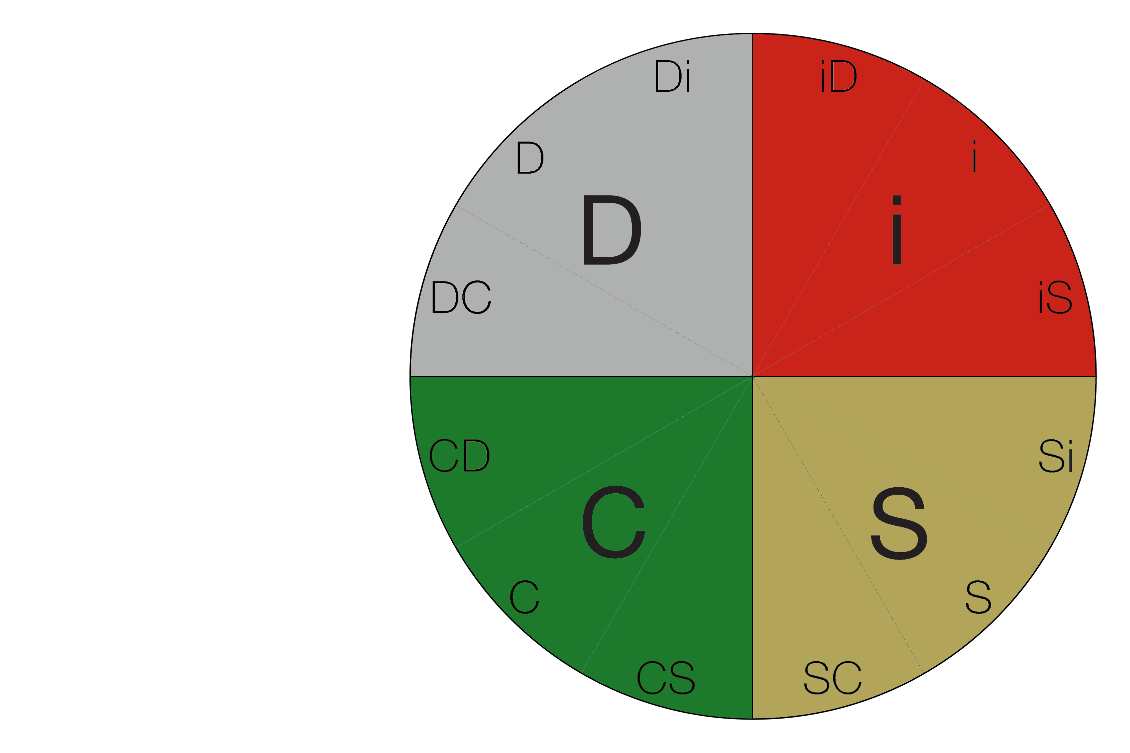
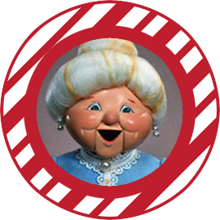
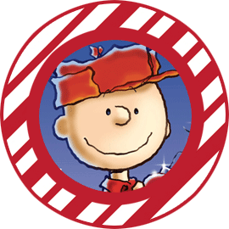
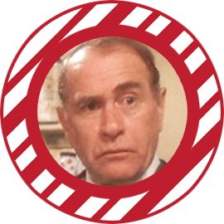
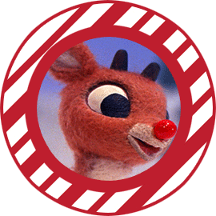
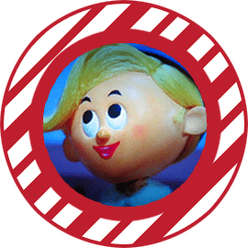
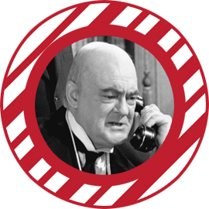
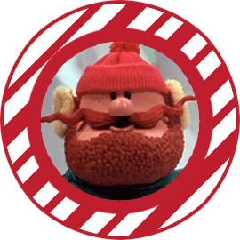
Map the holiday characters to their DiSC Styles
Mrs. Claus
Buddy the Elf
Charlie Brown
Frosty the Snowman
George Bailey
The Old Man Parker
Scott Calvin/Santa Clause
Rudolph
The Grinch
Hermie the Elf
Mr. Potter
Yukon Cornelius
Brought to you by Bishop House Consulting, Inc. www.bishophouse.com

Slide 2
Instructions
Welcome to our Holiday Fun and People-Reading Holiday Series!
We’ve created this fun exercise to help you and your team to celebrate, build and practice your DiSC knowledge. We have secretly ascertained the DiSC styles for some holiday characters and personas that we’ve all come to know. In the graphic above you’ll see the characters on the left side.
With your team, project the first slide graphic. As your team discusses a character, move that character to the spot on the DiSC map which best represents their perceived style. The “discussion” is your key opportunity to make DiSC sticky so be sure to promote active and fun debate.
Every couple of days we will post several characters from the list to the DiSC map – and share DiSC tips – so play along!
DiSC has two primary purposes. First, to learn more about your own style – increasing your self-awareness and helping you build your natural talents. Second, DiSC is a tool that helps you understand how to adapt your approach in working with others – increasing your effectiveness in working, and communicating, with others.
Being able to identify other’s styles – people reading – is the first step in learning how to work with people of different styles. Our Merry DiSCember exercise will help you and your team practice your people reading skills.
Learn more about people reading below!
Brought to you by Bishop House Consulting, Inc. www.bishophouse.com

Slide 3
People-Reading: The “How Tos” You May Need
Here’s a reminder on how to people read. Think about the person’s behaviors – their tendencies, tone of voice, expressions, word choice – and respond to these two questions.
Question 1: What’s the person’s pace? Is the person more fast-paced & outspoken or more moderate pace & reflective?
Question 2: How “agreeable” is the person? Is the person more questioning & skeptical or are they more warm and accepting?
Combining the answers to those 2 questions (see model below) to determine the individual’s DiSC tendencies.
Brought to you by Bishop House Consulting, Inc. www.bishophouse.com
“DiSC”, “Everything DiSC” and “The Five Behaviors of a Cohesive Team” are a registered trademarks of John Wiley & Sons, Inc.

